Slide 1
Modeling data in no sql
Data modeling

Slide 2
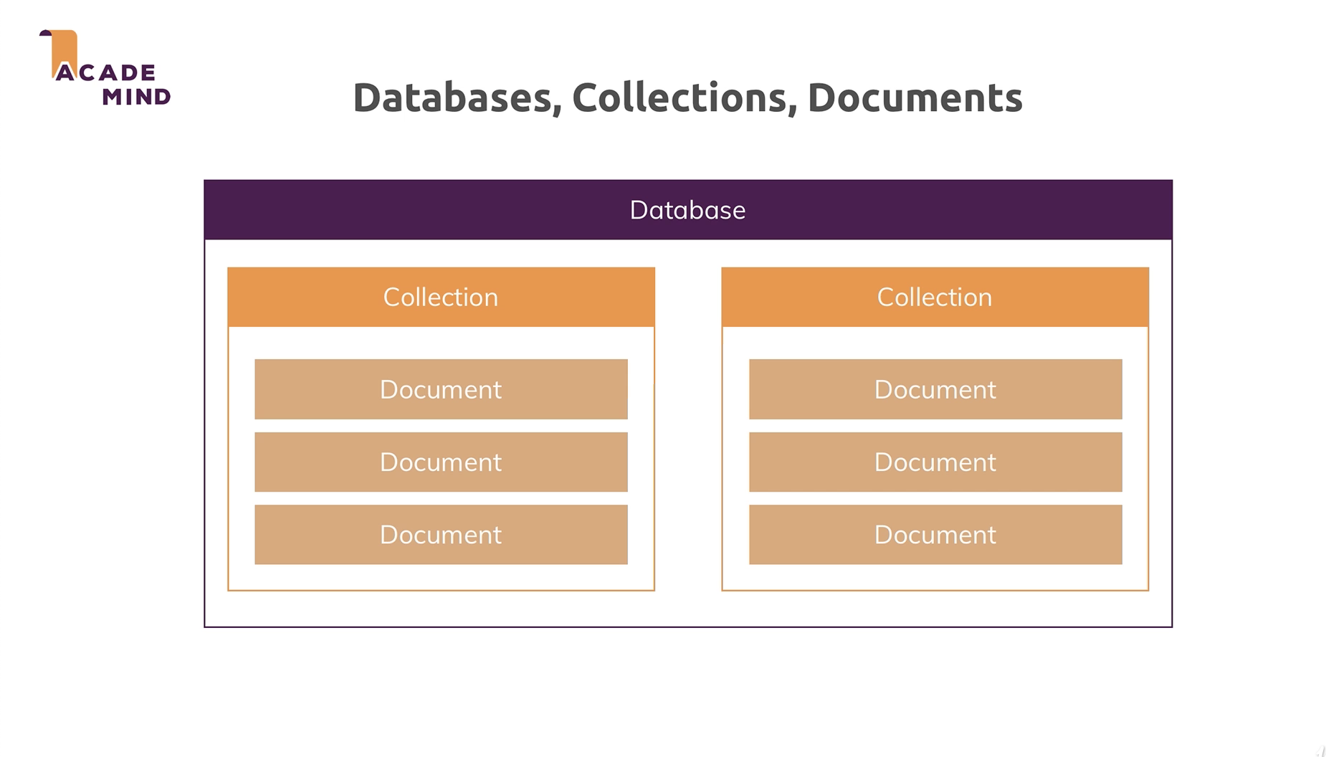
Relation between database, collection, documents in noSql
Collection is a table in a SQL database
Document are the data pieces you are storing

Slide 3
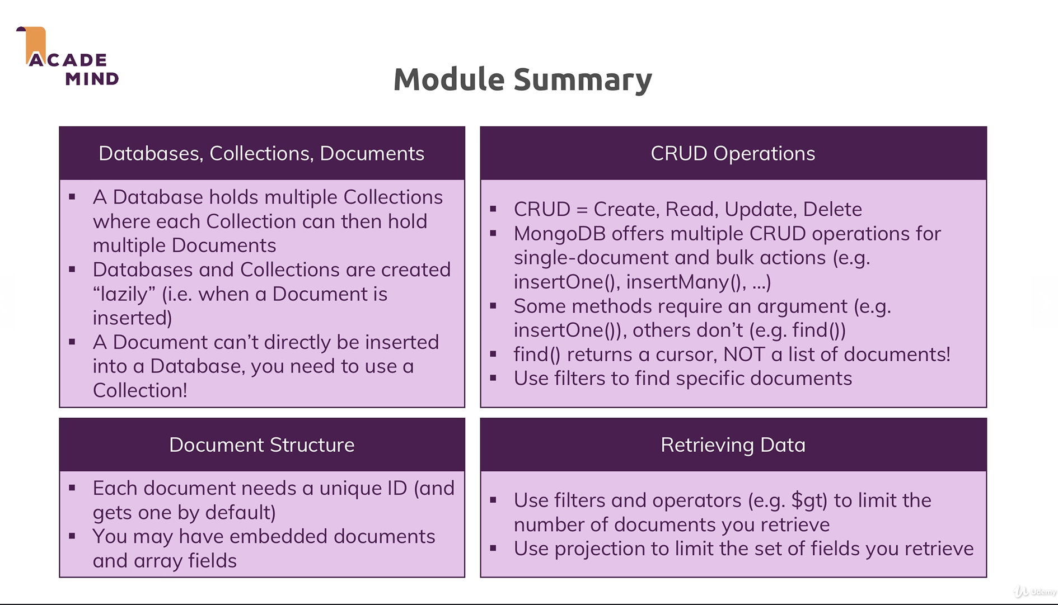
Overall NoSql Concepts

Slide 4
Data modeling

Slide 5
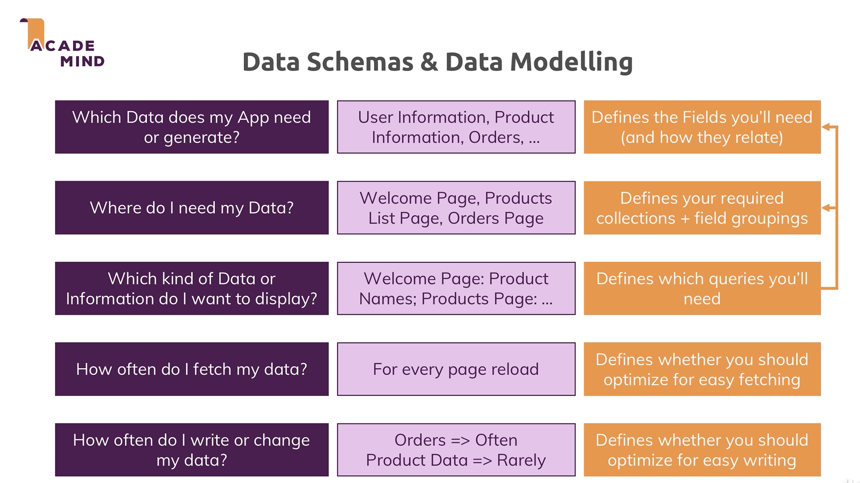
Questions to Ask When Modeling

Slide 6
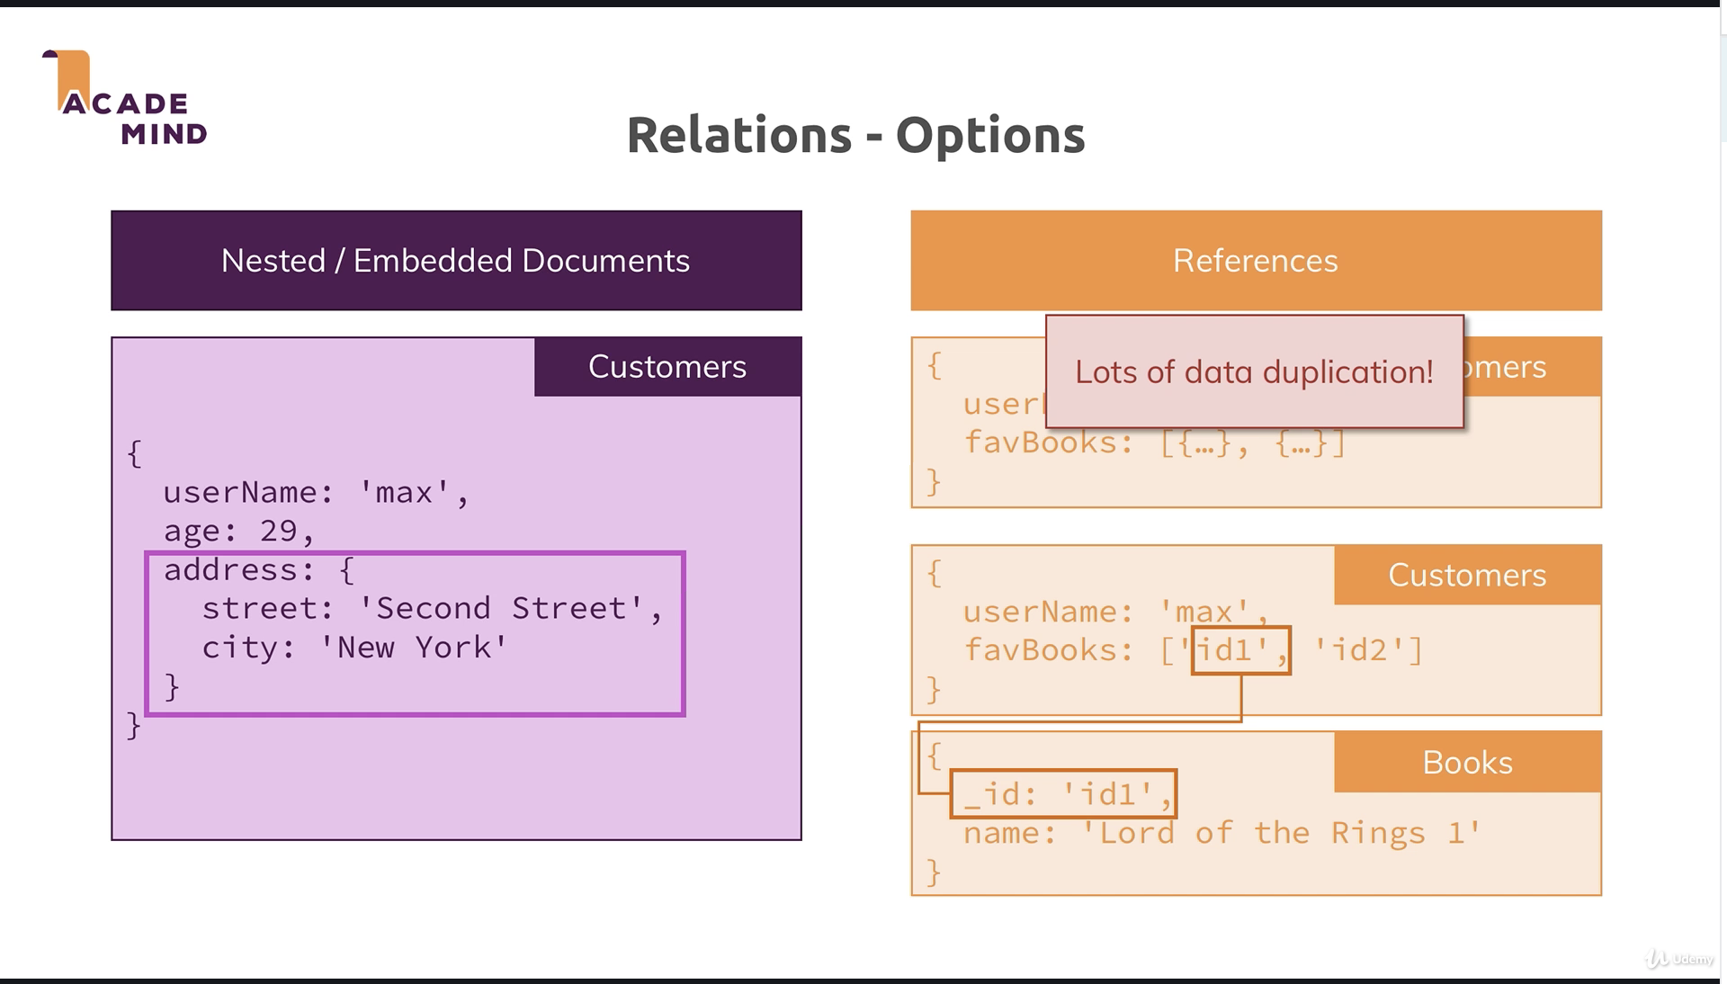
Two options in NoSql embedded or references

Slide 7
One to one using embedded document

Slide 8
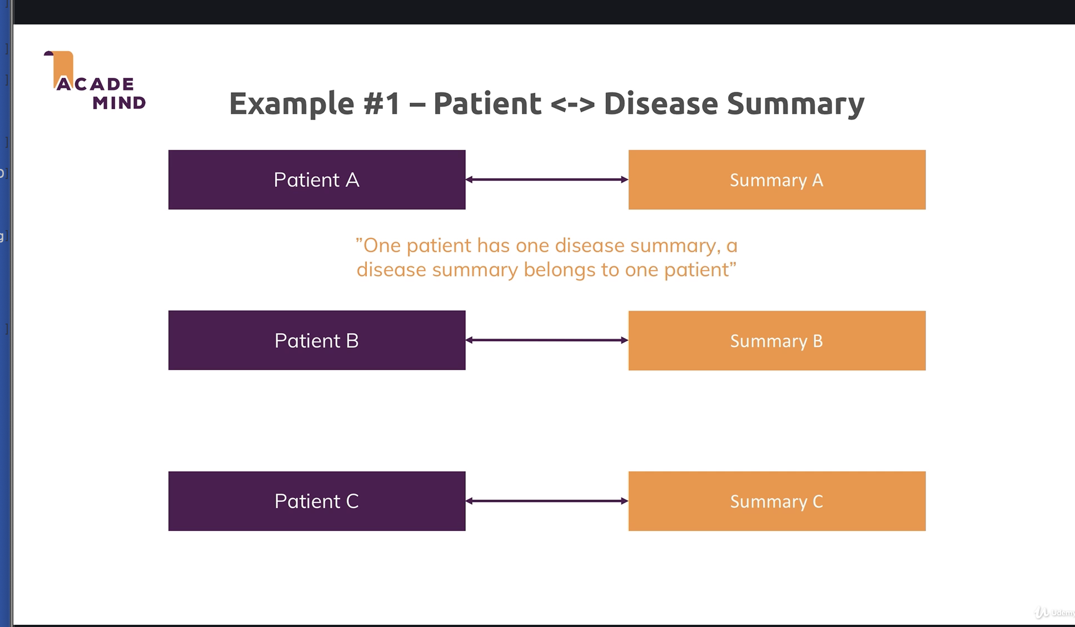
Example where embedded document makes sense

Slide 9
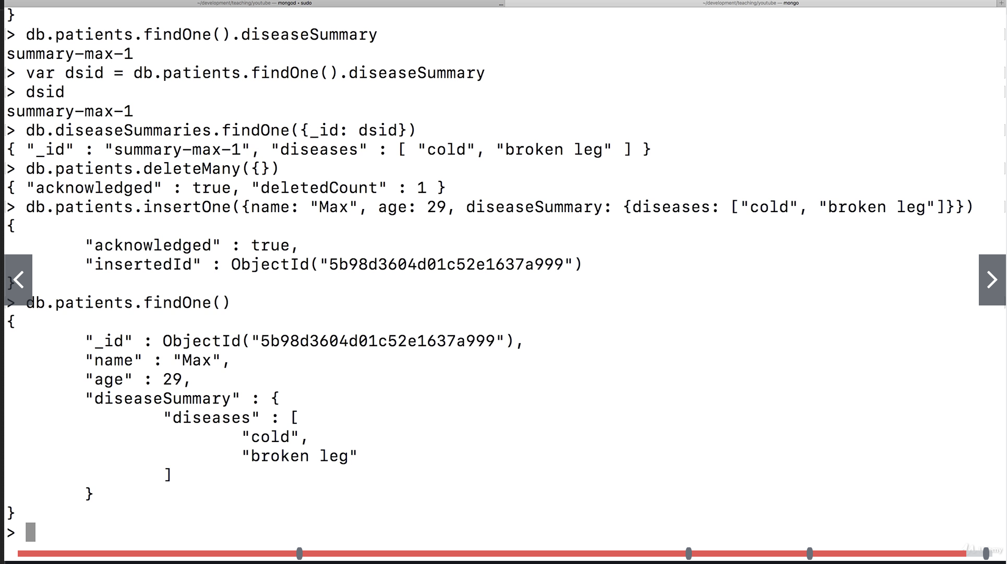
One to One Relationships = Use Embedded Document EXAMPLE. Good for a web application when you are working with a patient and associated attributes

Slide 10
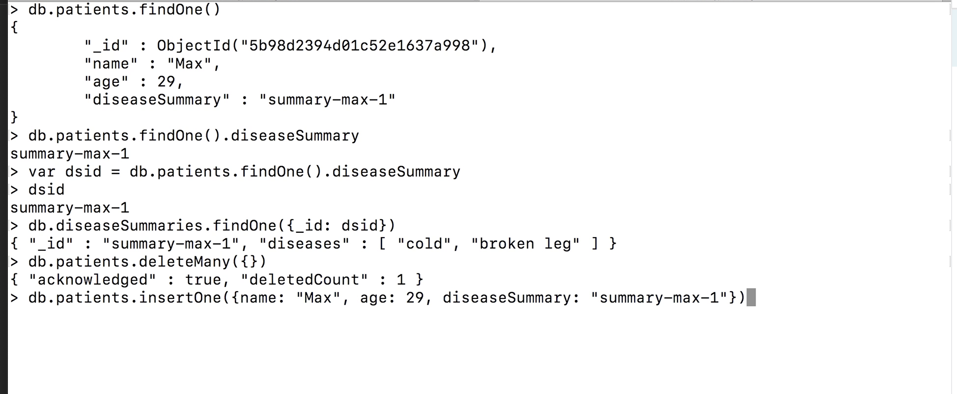
One to One Relationships using references EXAMPLE. You would need to perform multiple operations to get the data For a data analytics application it could be preferred because you would want to look at data across the document easily

Slide 11
One to one using references

Slide 12
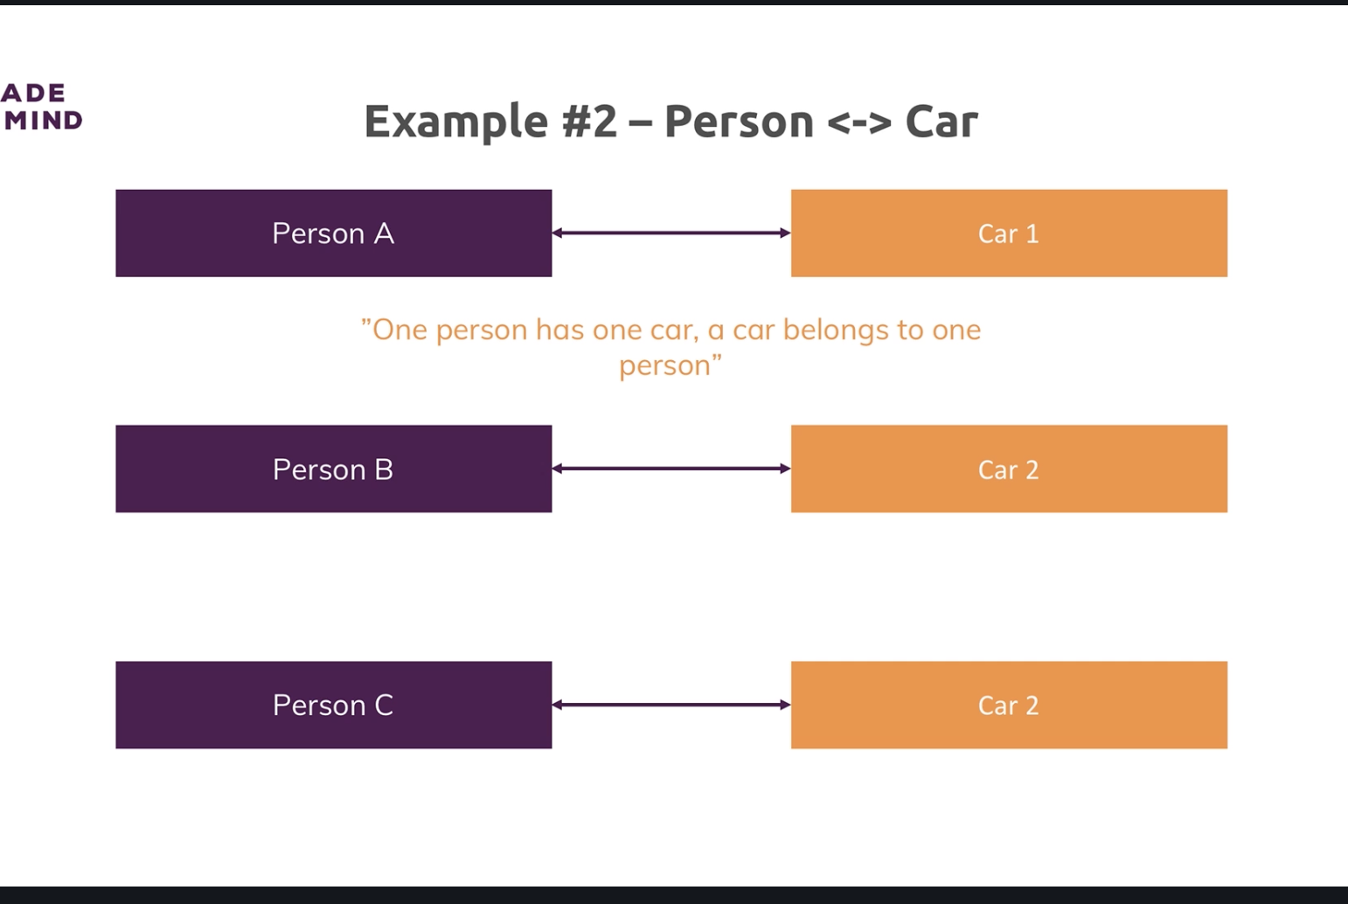
Example where references makes sense

Slide 13
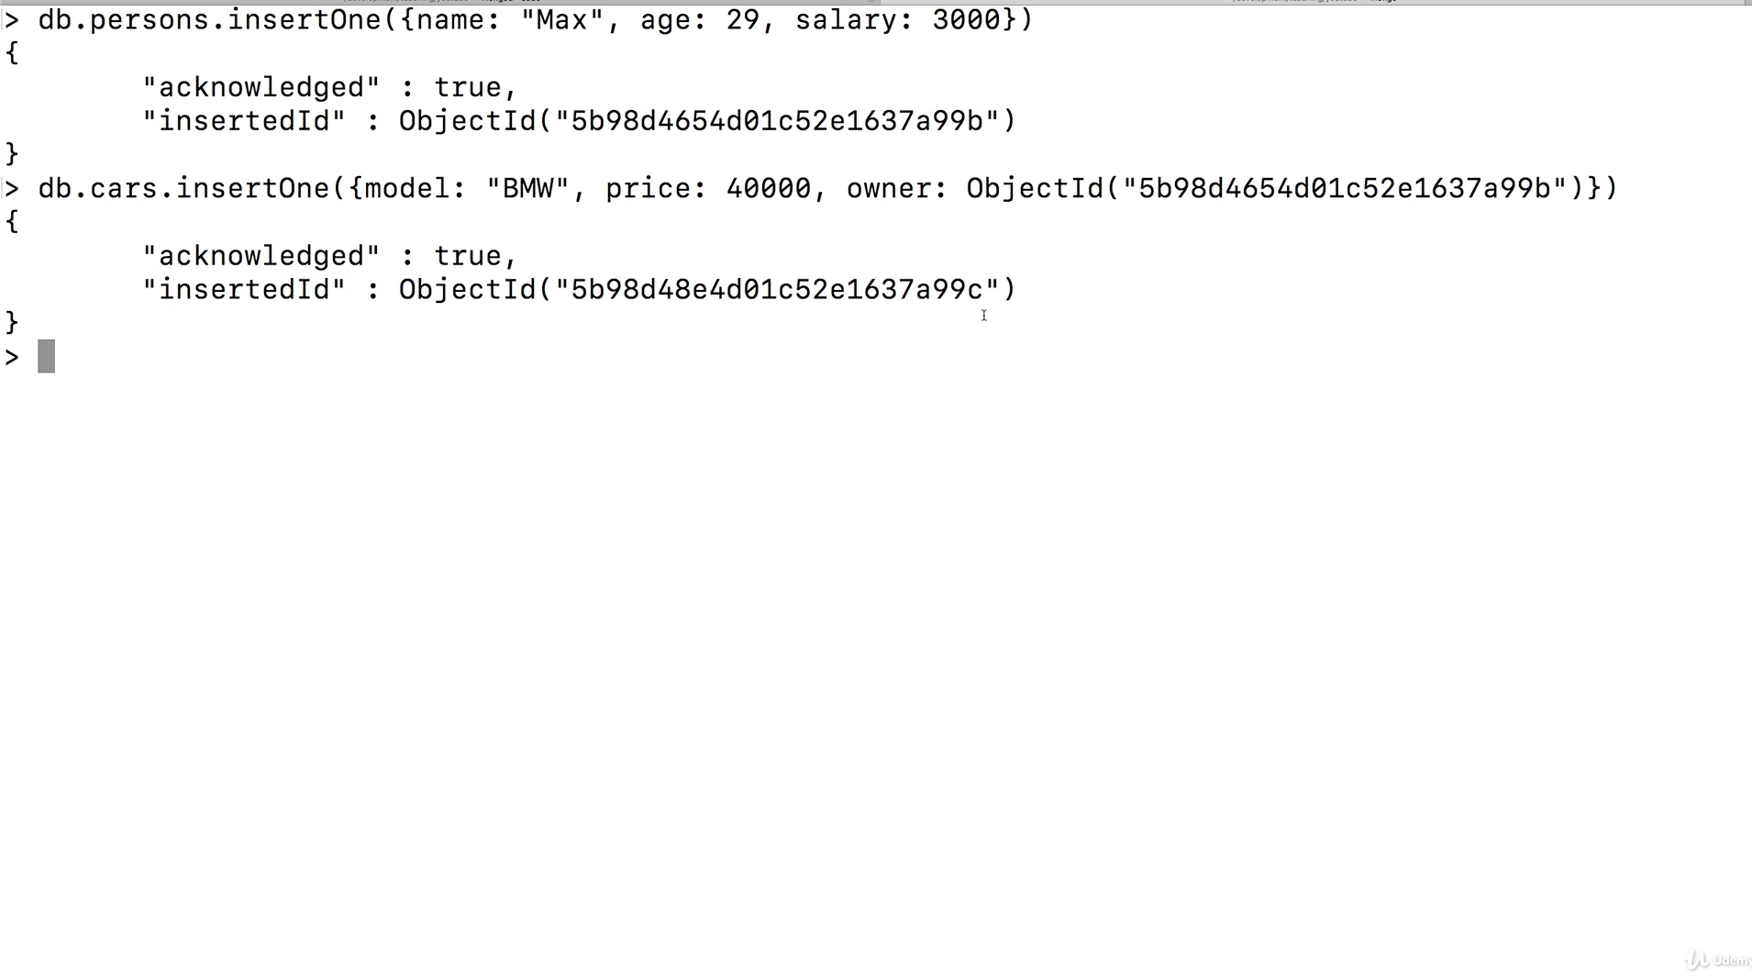
For a data analytics application we might want data in separate collections so it is easy to find what you need and do comparisons rather than having to query within each document to get the data required

Slide 14
One to many - embedded document

Slide 15
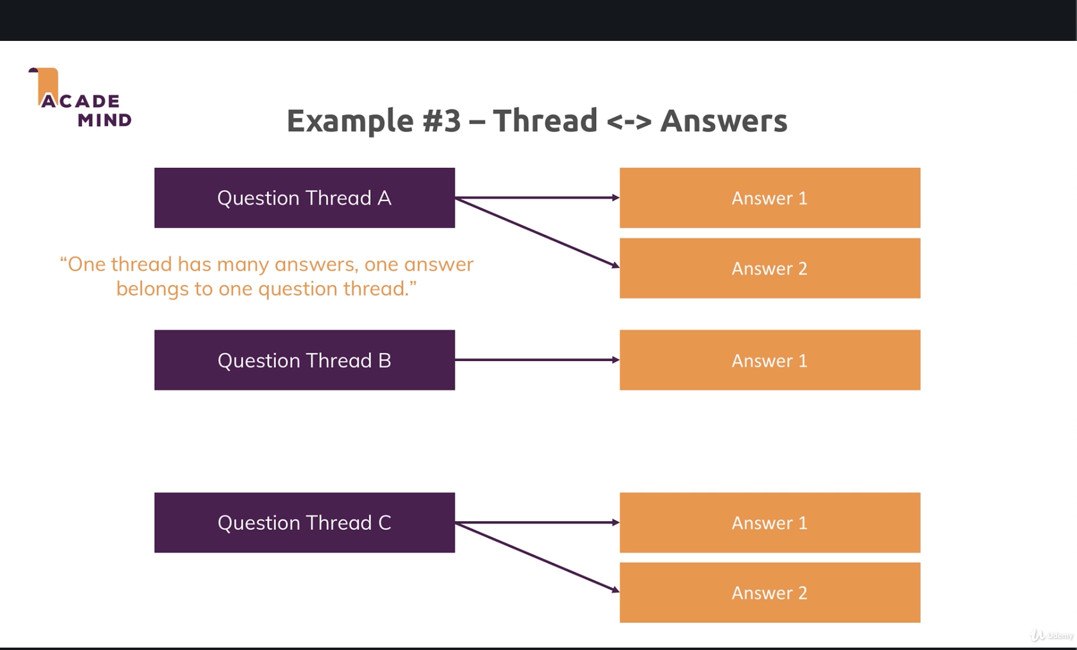
One to Many Relationship where embedded document makes sense

Slide 16
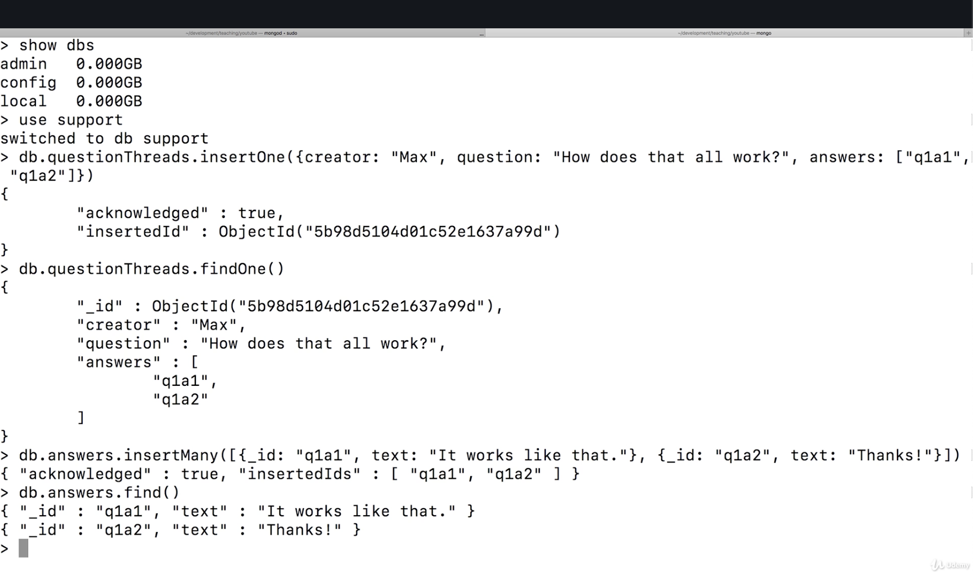
THE QUESTION IS HOW DO YOU MODEL THE QUESTIONS? ABOVE IS REFERENCES APPROACH = might not be ideal since you have to make multiple queries to get the data you need. Ie you would need to first query questions to get the id and then use id to get the answer

Slide 17
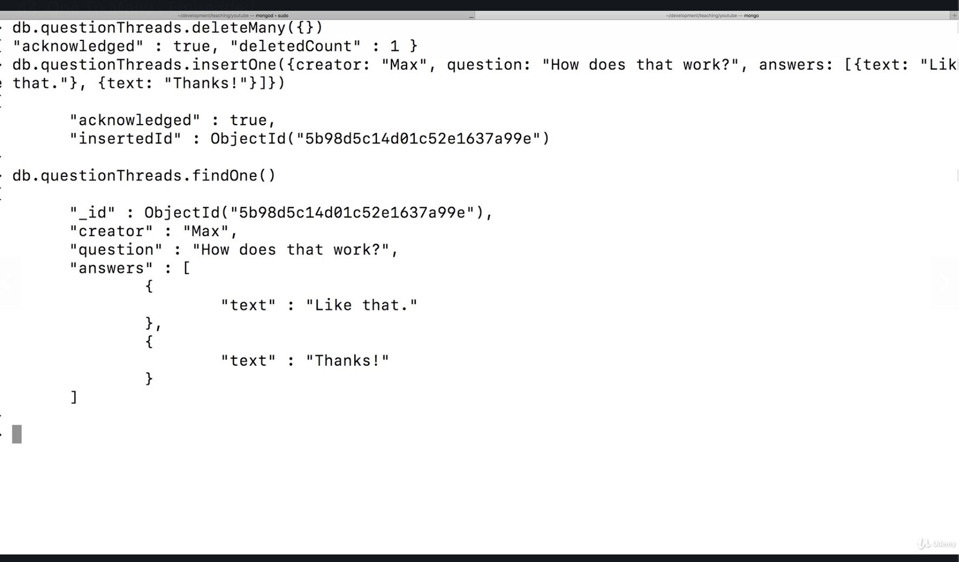
EMBEDDED MIGHT BE BETTER SOLUTION: Here the questions and answers are stored in the same document for easy retrieval. For ex. A good use case is posts and responses to posts.

Slide 18
One to many - references

Slide 19
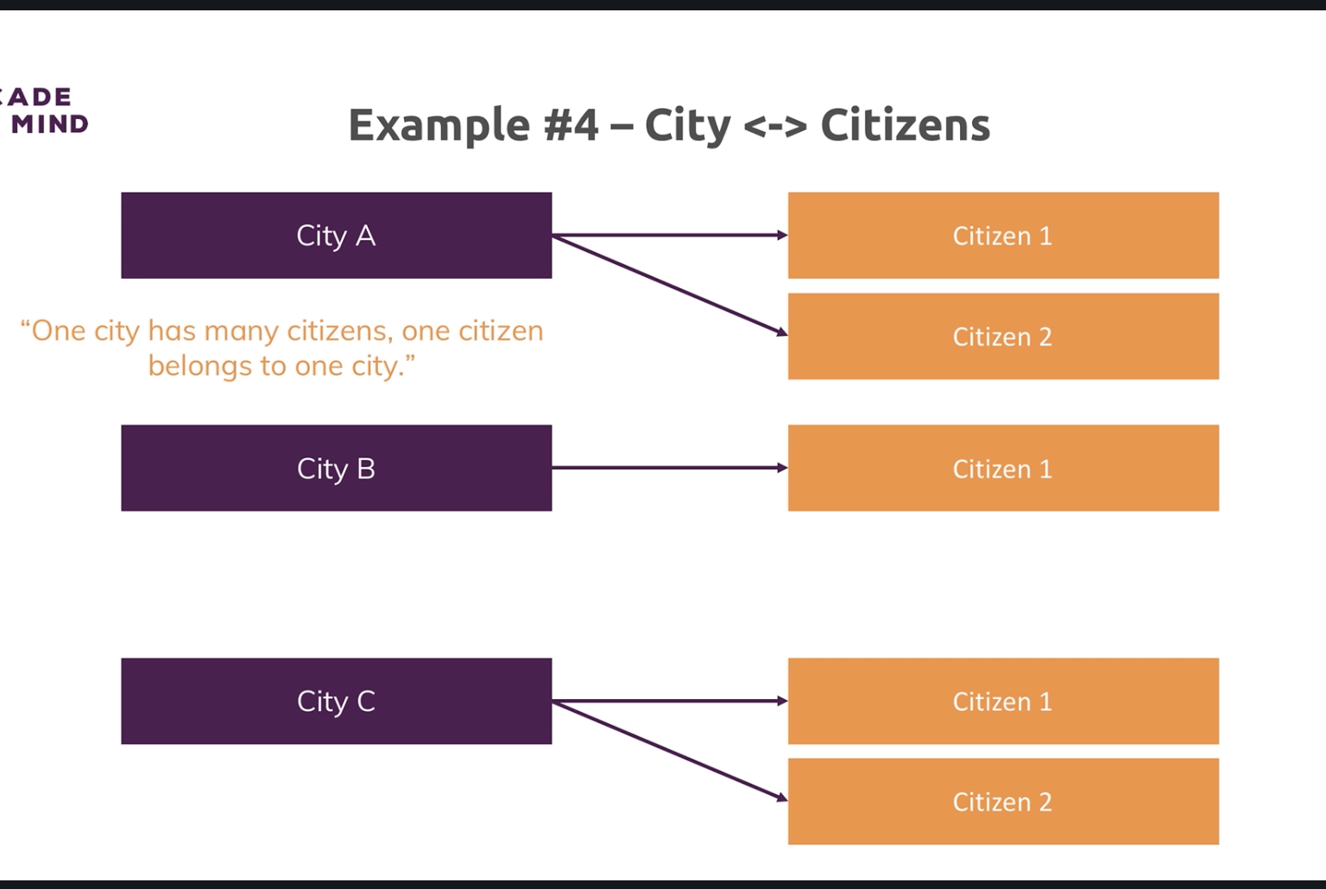
One to many where references makes sense. Citizens will be very large so you don’t want all citizens when you just care about cities

Slide 20
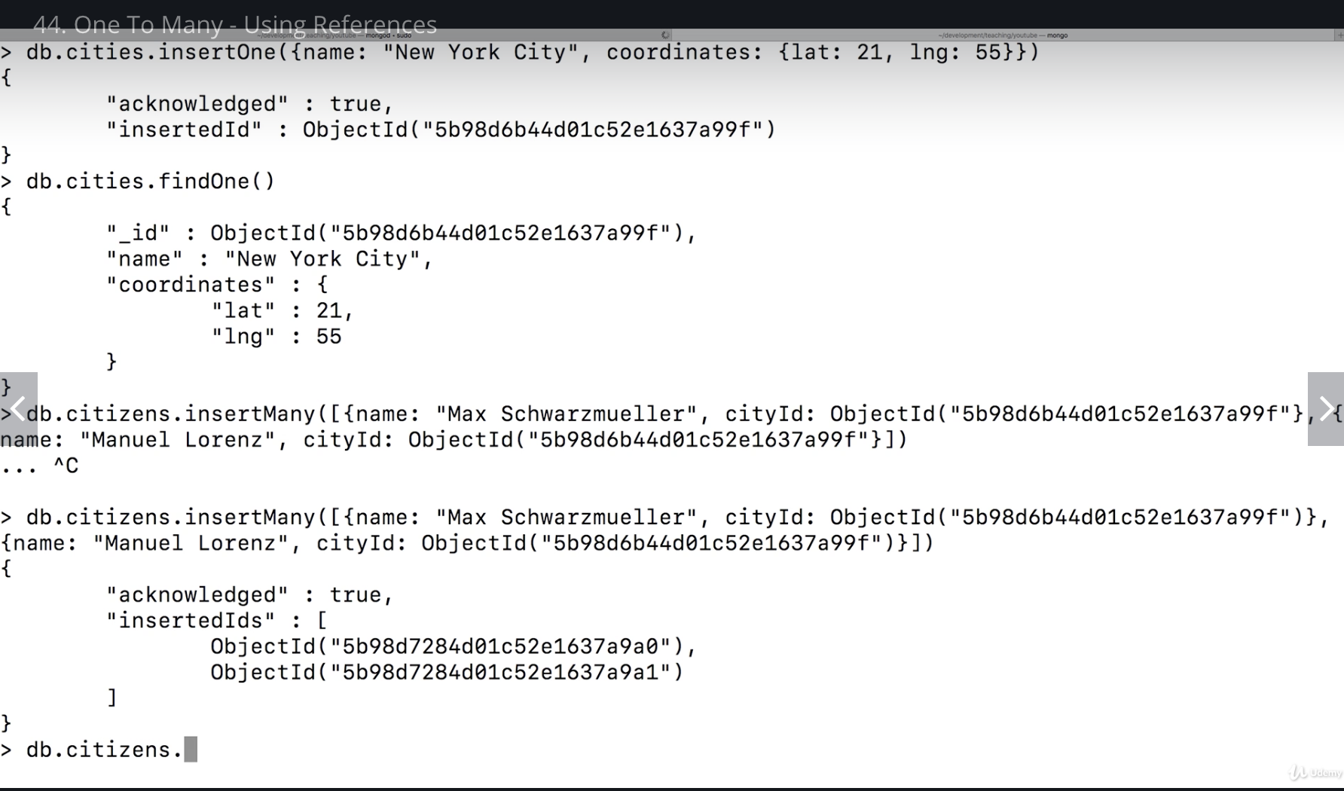
If you have many citizens you might exceed the document limit of 16mb so in this case it might be beneficial to have a separate citizen and city collection. OTHERWISE you just cities you would have to also query all citizens which could get very long

Slide 21
Many to many - embedded document

Slide 22
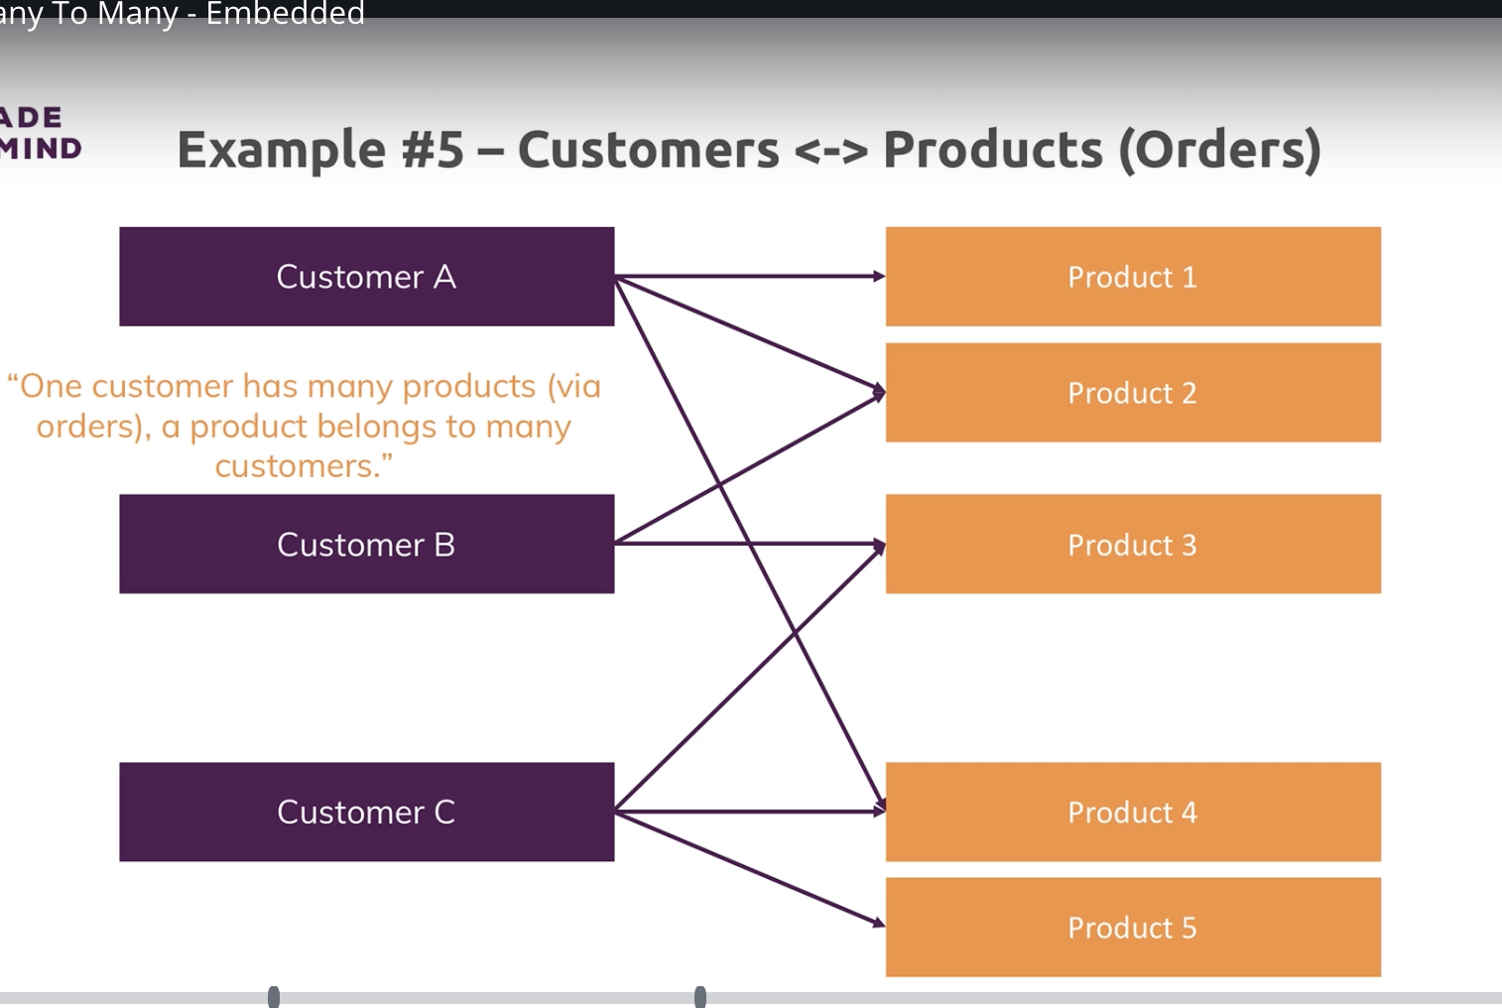
Many to many where embedded document makes sense

Slide 23
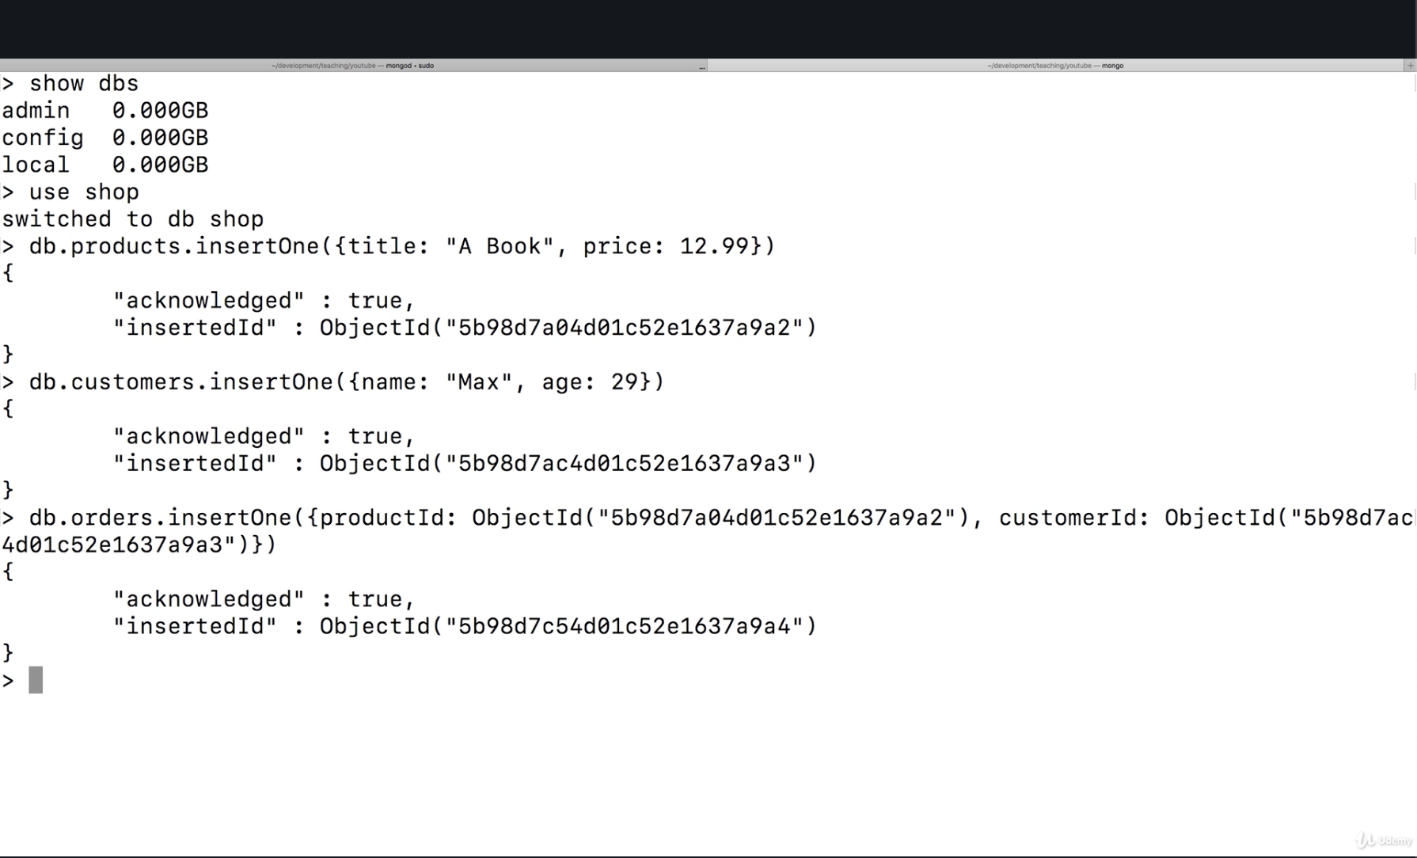
This is using references. Three different tables linked by object id. This is a very sql approach

Slide 24
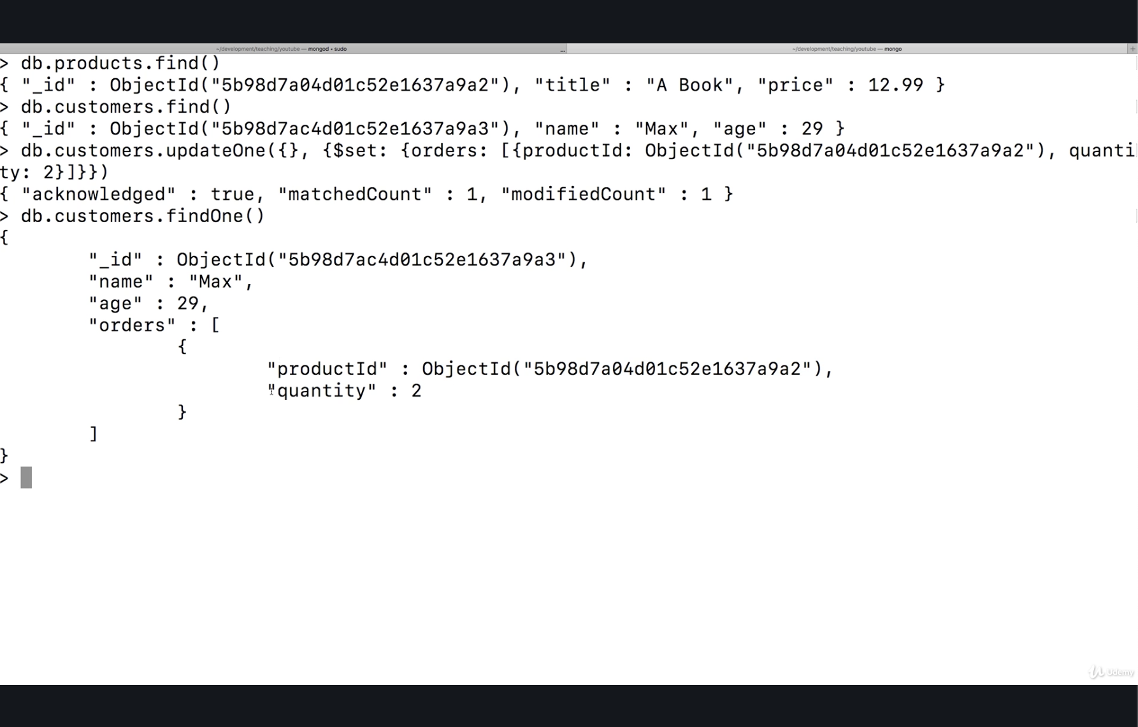
This is also using references but only two tables = an advantage of noSql over SQL

Slide 25
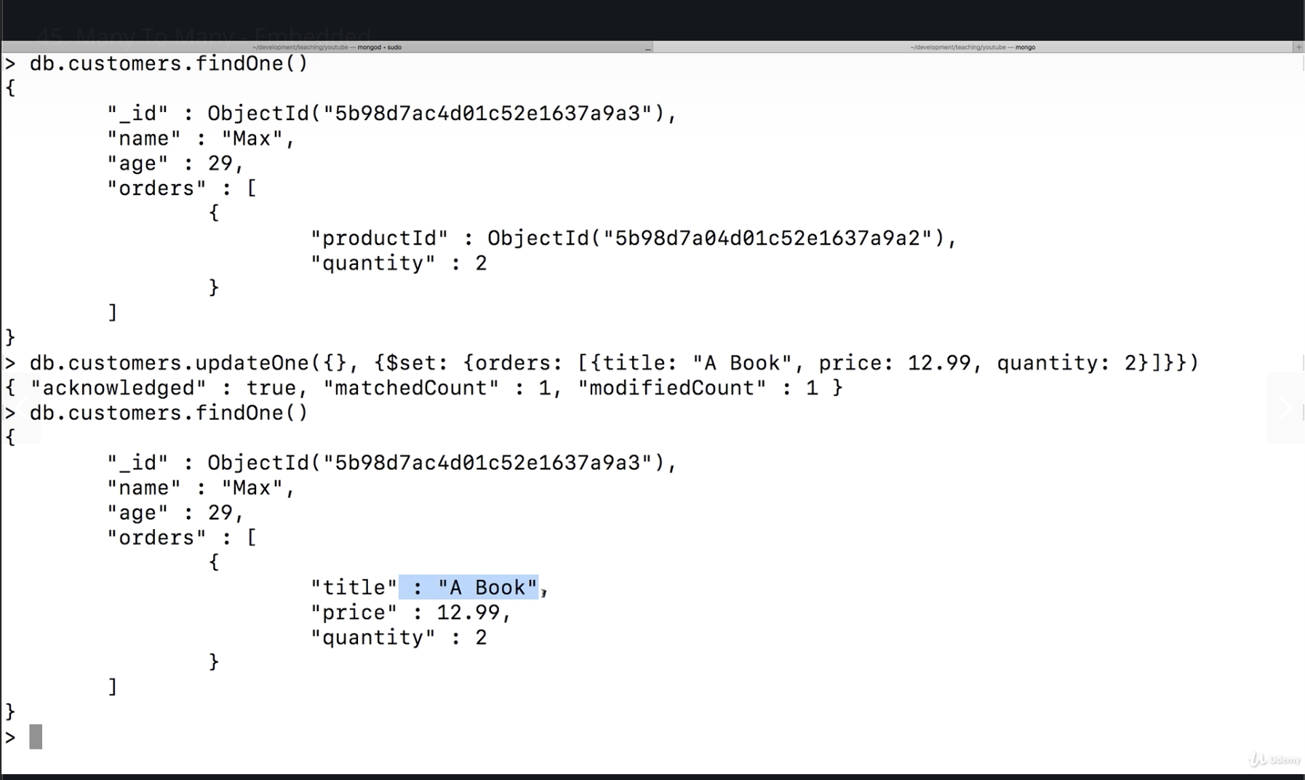
Here is an embedded many to many relationship. Downside is that a customer might order the product multiple times. When you update a product you would need to update it in the product collection and in the customer collection > order. However from an application perspective it may be acceptable to just take a snapshot of data at a given time. You could update the product table only and just say that the orders within customers are just a snapshot in time. A book probably would not change to a T shirt. Even if price changed, it was a thing of the past. For this reason we can duplicate data in customers and product table without causing many issues.

Slide 26
Many to many take away
Don’t automatically assume that if there is a many to many you should always use references over embedded
ASK THE FOLLOWING
How do you fetch your data
How often do you change your data
If you change do you need to change it everywhere or is duplicate data acceptable?
If you have an application where you take a snapshot of the data you may not worry about duplicating data because if you change the master list you would not have to update data everywhere

Slide 27
Many to many - references

Slide 28
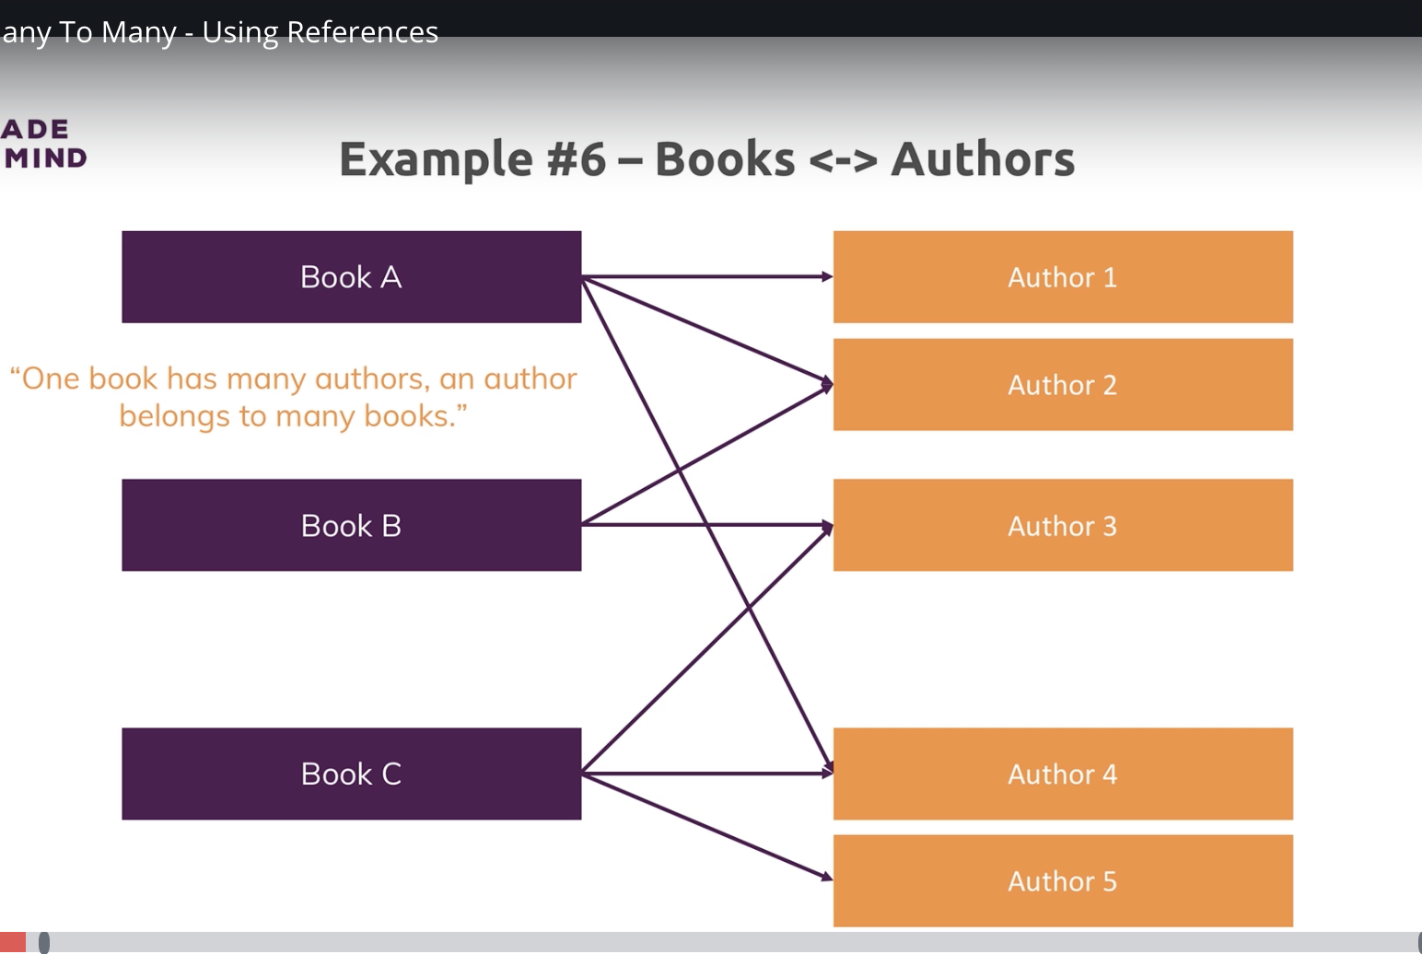
Many to many where references makes sense.

Slide 29
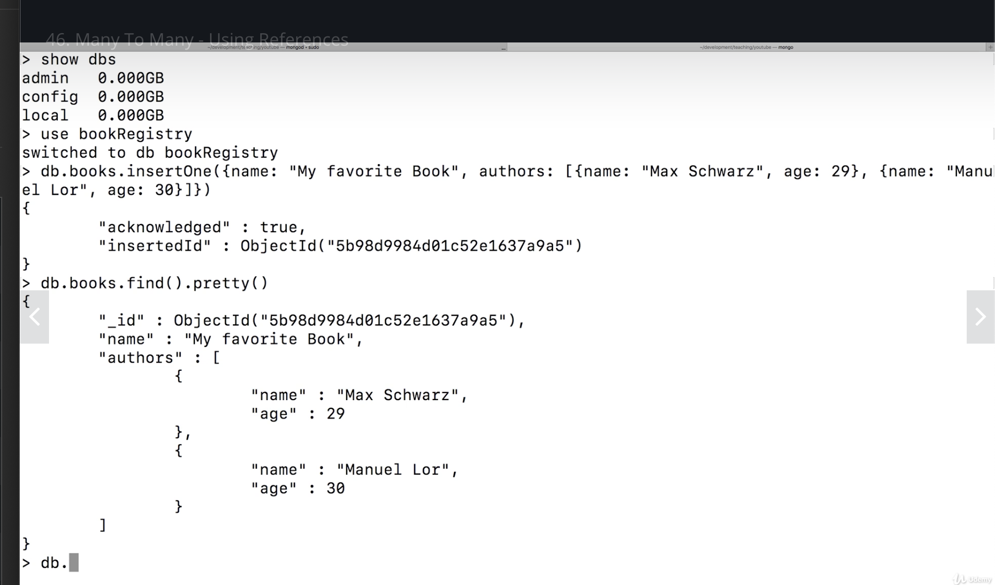
EMBEDDED EX. Here if you need to update books you also need to update the authors collection and vise versa if an author name/age changes.

Slide 30
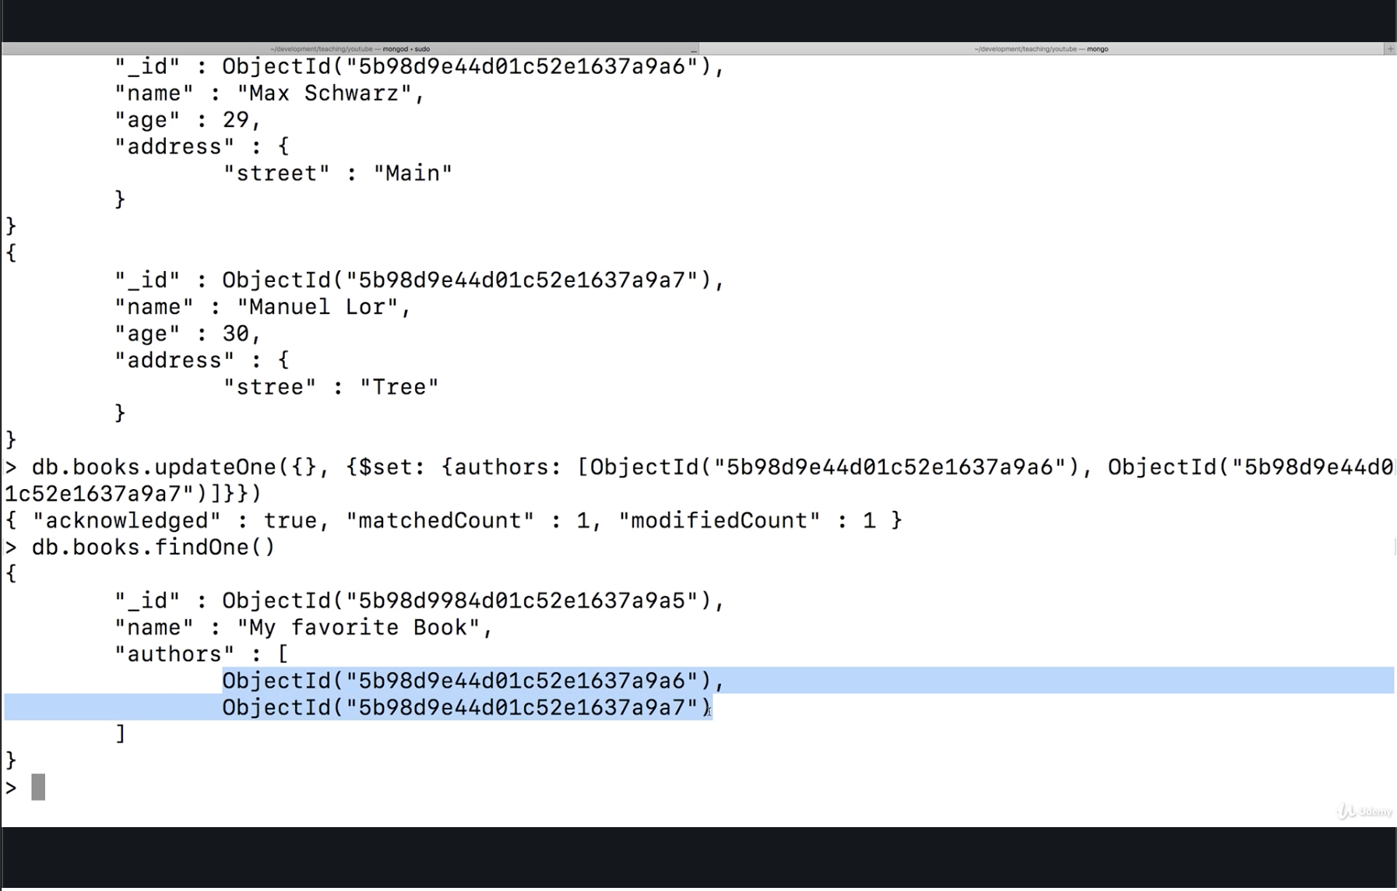
References EX. Since books and author data might change frequently, create separate collections. Within books collection just store object id and use that to get the associated data where needed.

Slide 31
Take aways - relationships

Slide 32
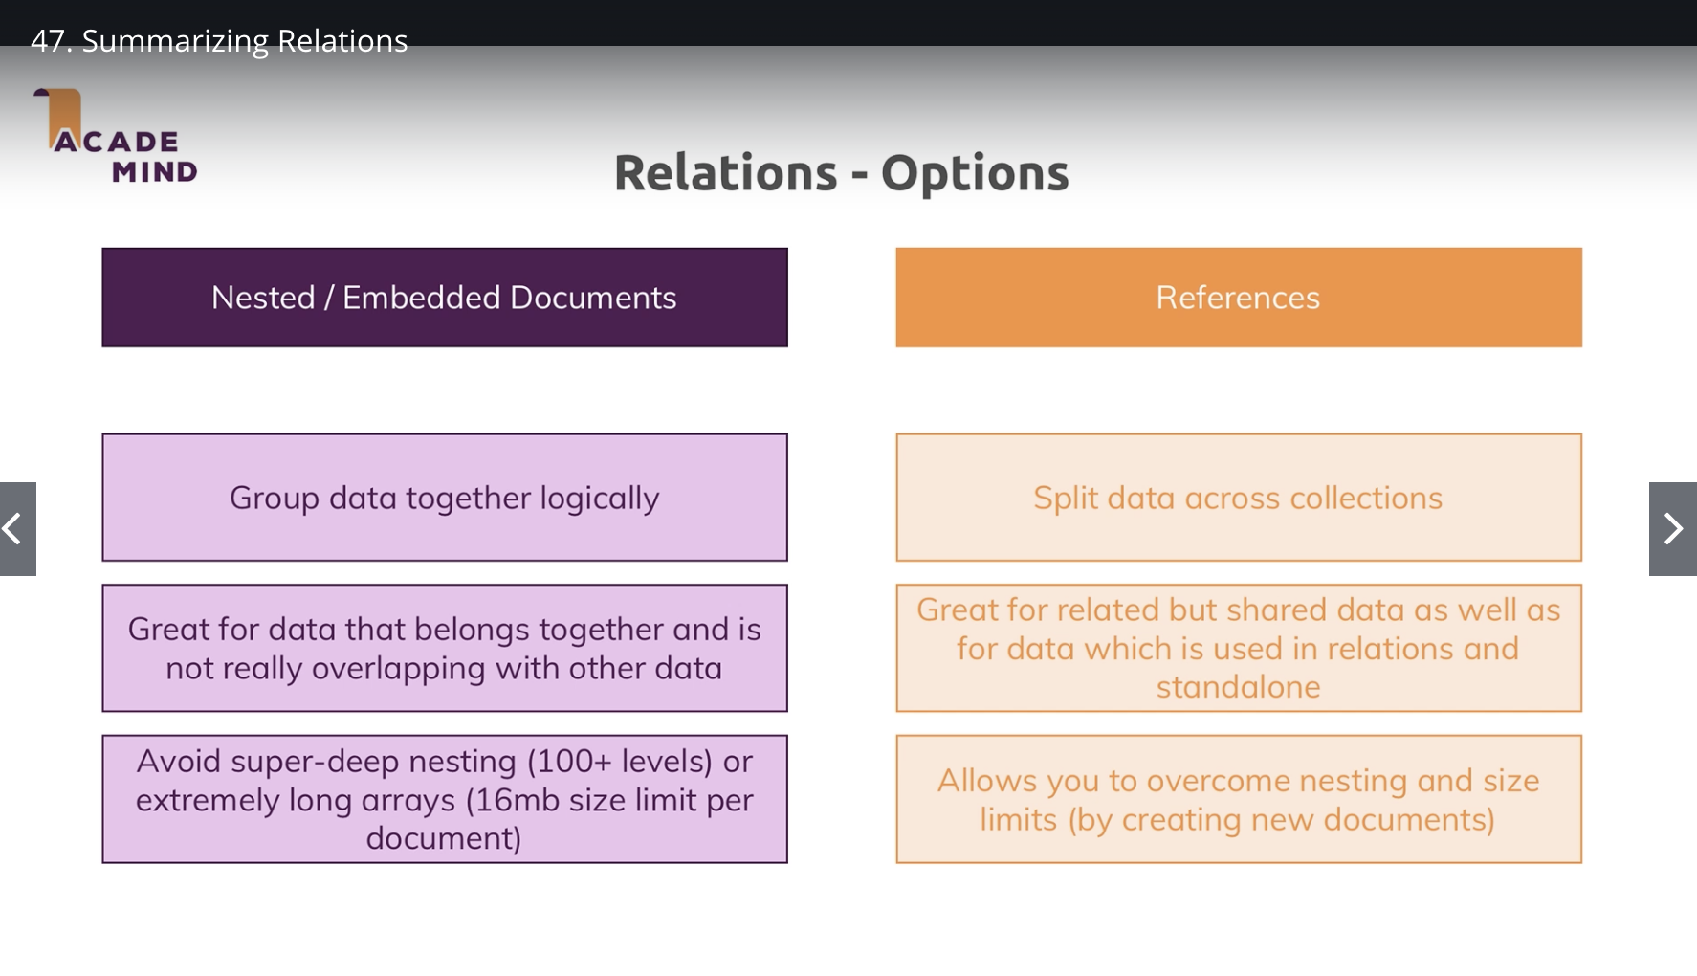
TAKE AWAYS

Slide 33
Lookup operator - remedy for splitting documents across collections

Slide 34
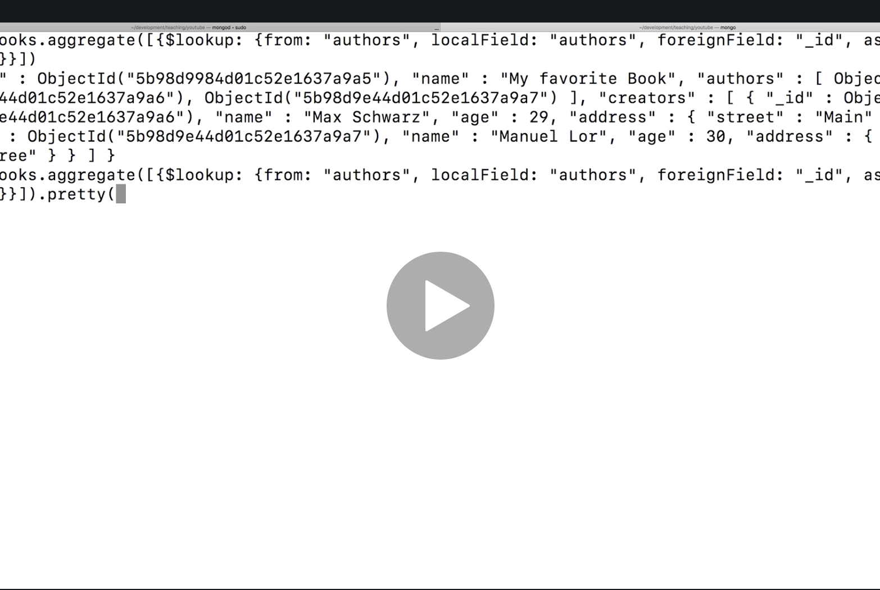
Aggregate and lookup operator to JOIN collections

Slide 35
Modeling exercise

Slide 36
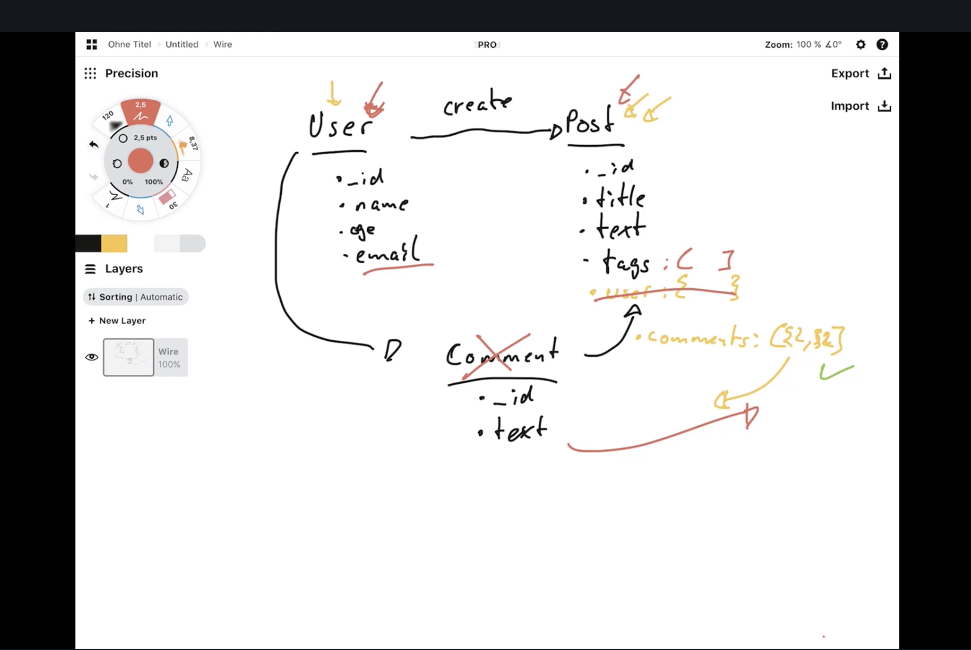
Modeling example. Two collections User and Post. Comment will be embedded in post. If we only went with a post collection, If user changes you would need to update all posts by digging into the post. One user can create many posts so nesting all in posts collection is a bad idea.

Slide 37
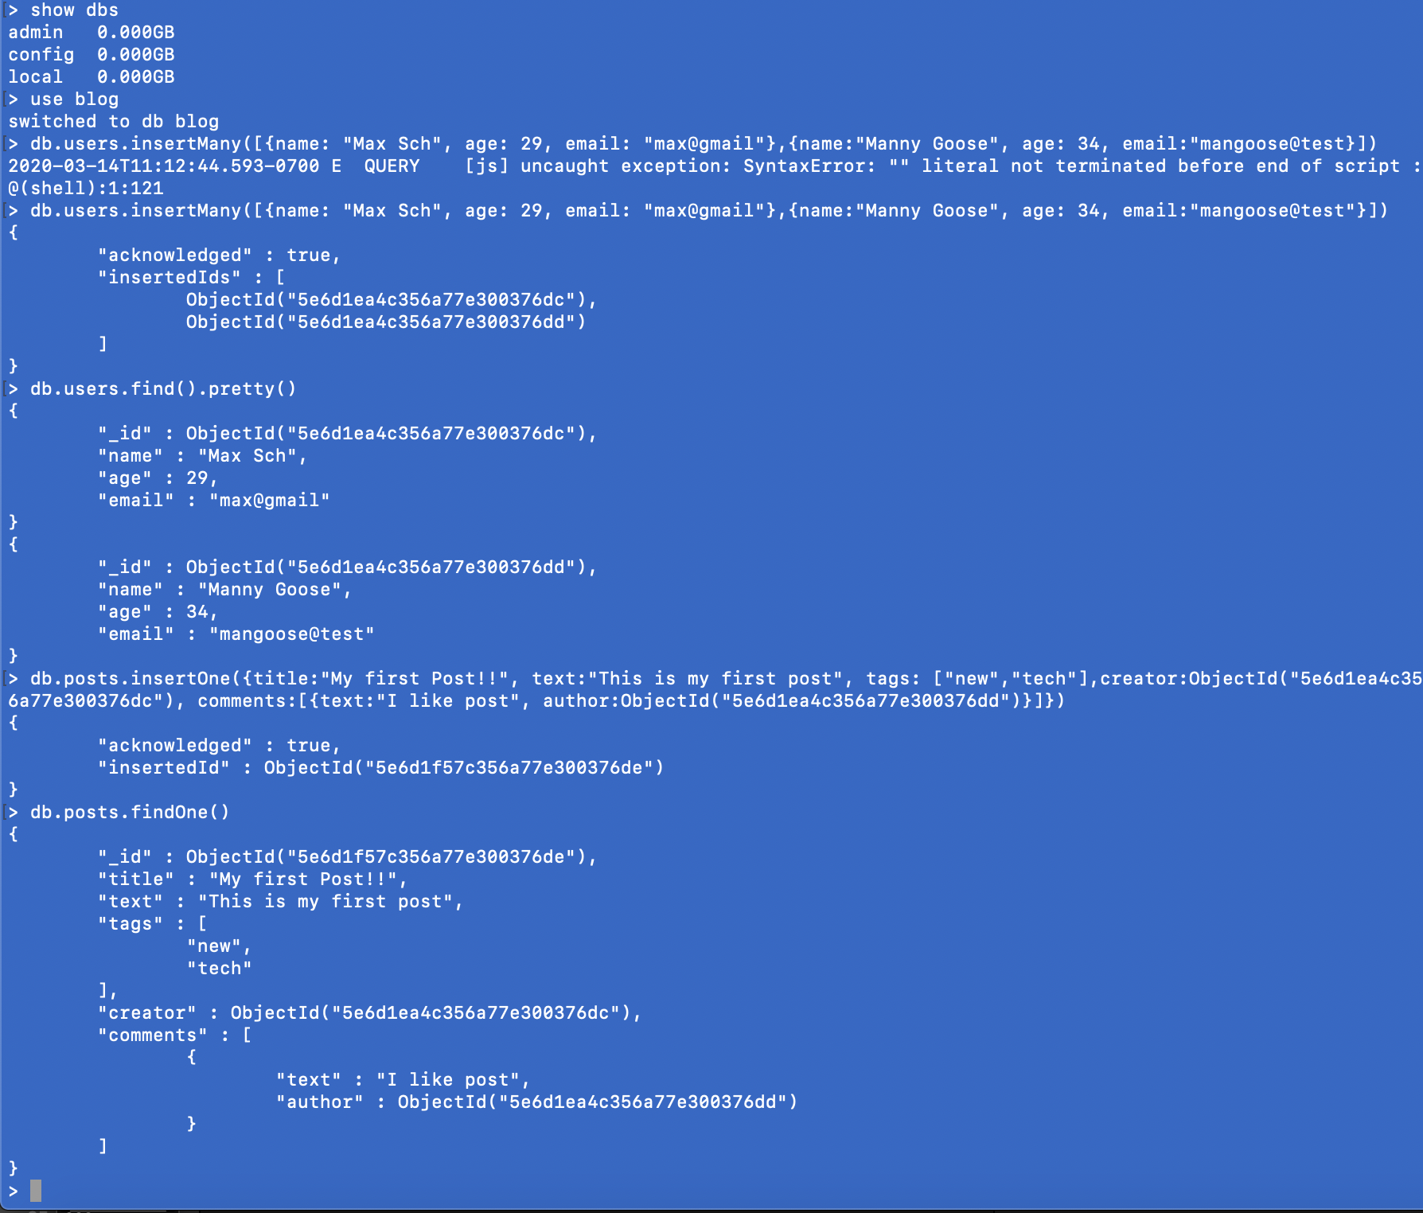
Example implementation of the modeling exercise

Slide 38
Schema validation

Slide 39
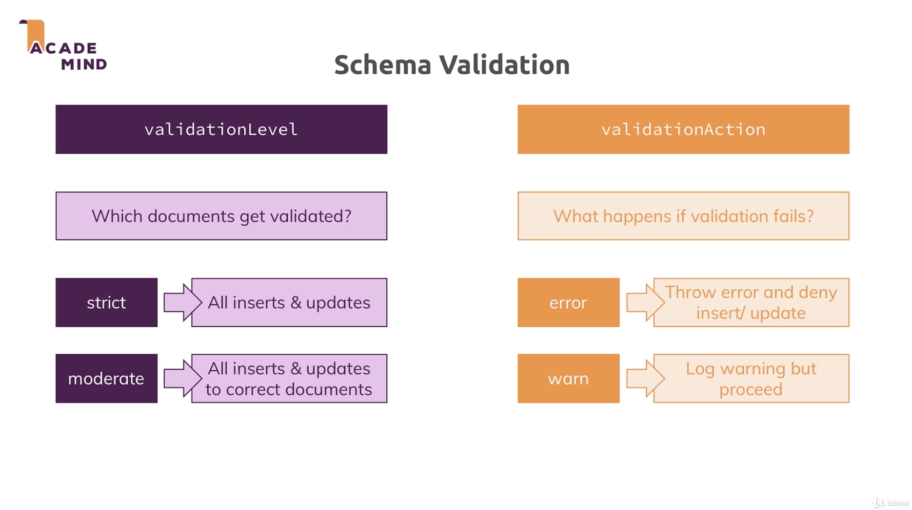
Options in validation

Slide 40
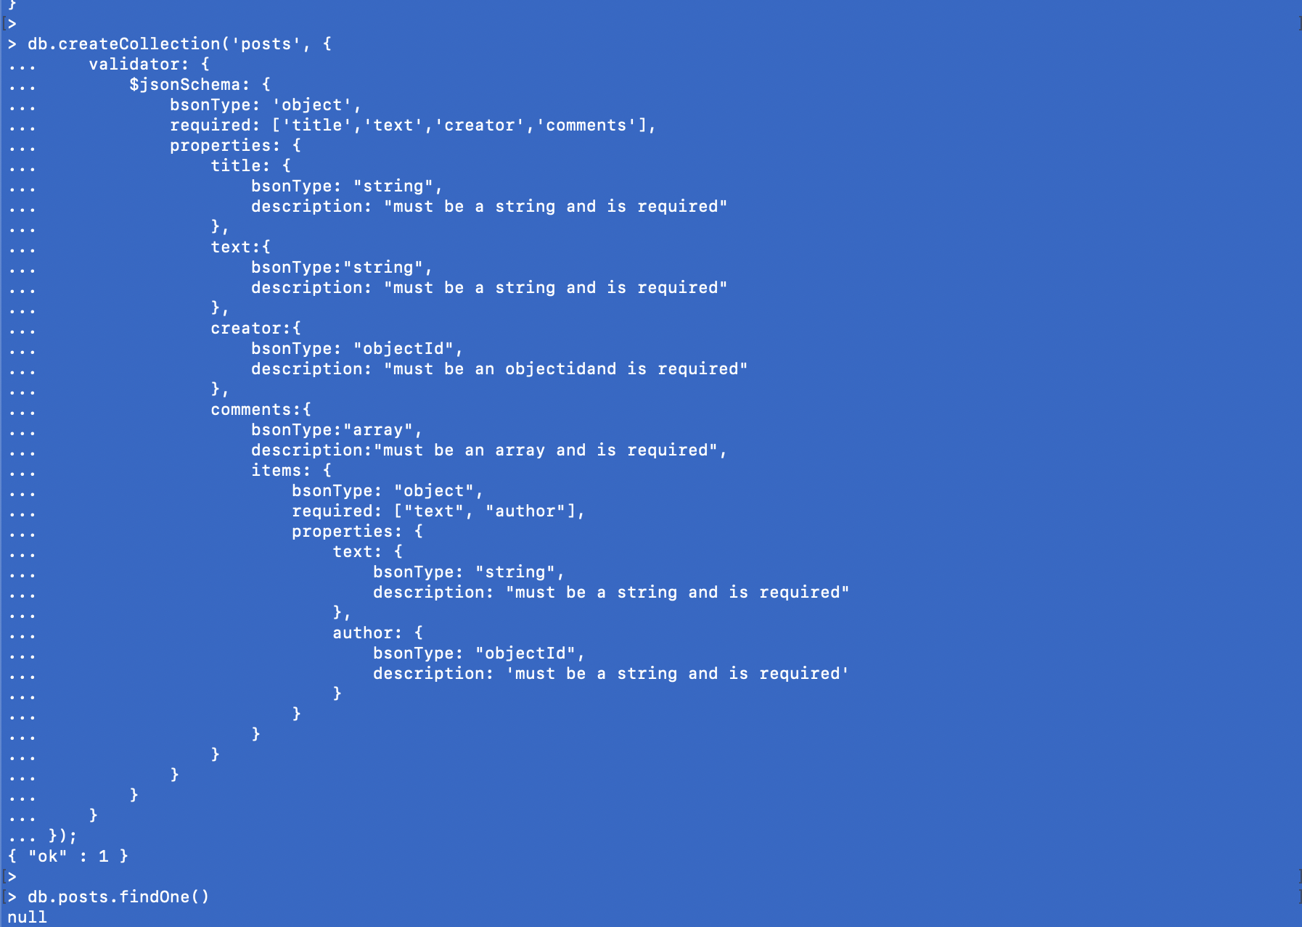
Type to enter a caption.

Slide 41
Wrap up!

Slide 42
Wrap up
In which format will you fetch your data?
How does your app or data scientists use your data?
How often will you fetch and change your data?
Do you need to optimize for writes or reads?
Read = duplicates are ok if they don’t change often
Write = avoid duplicates
How much data will you save and how big is it?
Lots of data = embedding might not be best option
How is data related? One one, many one, many many
Will duplicates hurt you?
Will you hit data storage limits?

Slide 43
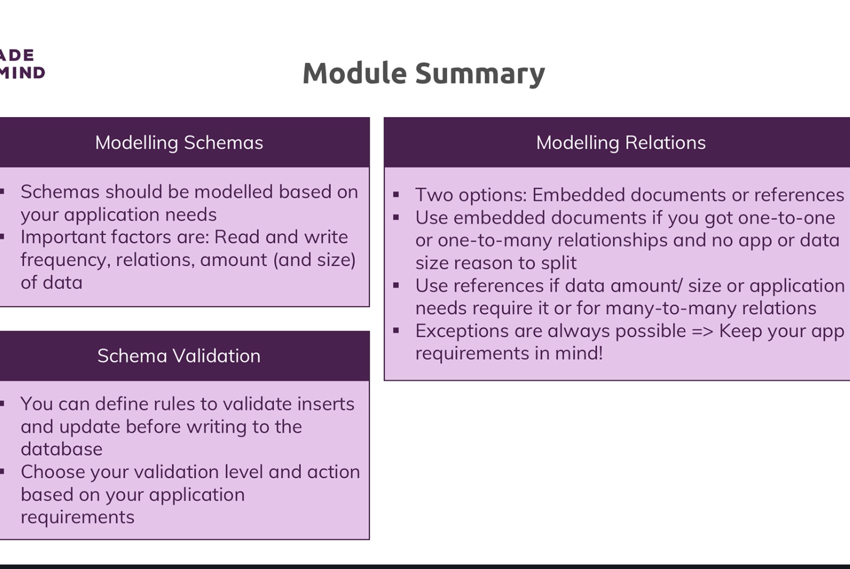
Type to enter a caption.

